Slide 1
Promoting excellence:
Standards for medical education and training

Slide 2

Promoting excellence – new standards

Slide 3
Promoting excellence – new standards
Launched July 2015
Came into force 1 January 2016
A single set of standards and requirements for all stages of medical education and training in one document Promoting excellence: standards for medical education and training
Reduces the regulatory burden
Notes:
New standards launched in July 2015.
They came into force on 1 January 2016.
For the first time, a single set of standards and requirements for all stages of medical education and training in the UK in one document Promoting excellence: standards for medical education and training
Later in the year, the GMC published an updated framework setting out how it will quality assure organisations’ progress against the new medical education and training standards.
The new standards reduce the regulatory burden on education and training organisations by reducing the total number of standards, criteria and requirements from 230 to 76.

Slide 4


Tomorrow’s Doctors & The Trainee Doctor
Notes:
The standards in Tomorrow’s Doctors and The Trainee Doctor were in force until the end of the 2015.
From 1 January 2016,
replaced the parts of Tomorrow’s Doctors and The Trainee Doctor called ‘the standards for managing and delivering medical education and training.’
The outcomes for graduates and provisionally registered doctors remain in force and are published on GMC website.

Slide 5

Framework for new standards
Notes:
Standards and requirements are organised around five themes:
• Learning environment and culture
• Educational governance and leadership
• Supporting learners
• Supporting educators
• Developing and implementing curricula and assessments

Slide 6

Ten standards centred around patient safety

Slide 7
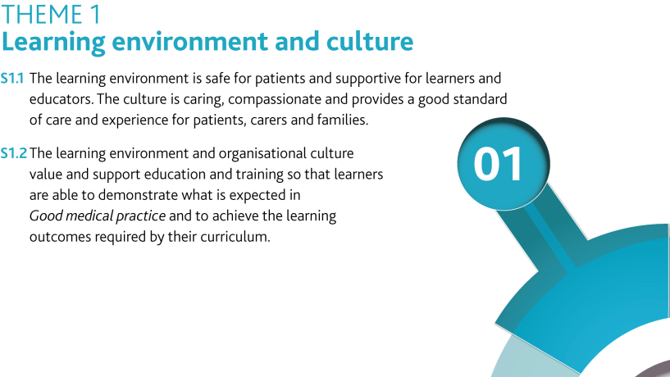
Theme 1: Learning environment and culture
Notes:
The new standards focus more clearly on the environment and culture in which medical students and doctors are learning in than the previous standards.
Where previously the standards were concerned about the impact of learners (medical students and doctors in training) on the safety of patients, the new standards make the link between an excellent learning environment being one that is also a safe environment for patients and has a culture that is caring, compassionate and provides a good standard of care and experience for patients, carers and families.
An excellent learning environment must show that education and training is valued and supported.
[See also the requirements under this theme].

Slide 8
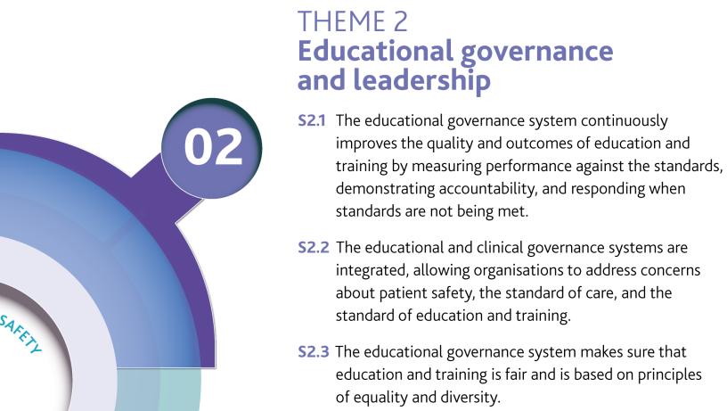
Theme 2: Educational governance and leadership
Notes:
This theme is about making sure that organisations have effective systems of educational governance, leadership and accountability to manage and control the quality of medical education and training.
In particular, this theme addresses how organisations work together to manage quality and share their concerns and good practice - much of the teaching and learning takes place outside medical schools and LETBS; managing quality involves working closely with other organisations.
Equality and diversity is one of the standards: ‘The educational governance system makes sure that education and training is fair and is based on principles of equality and diversity.’ (S2.3)
Equality, diversity and opportunity runs through the standards and requirements; but it is no longer a stand alone domain.
[See also the requirements under this theme].

Slide 9
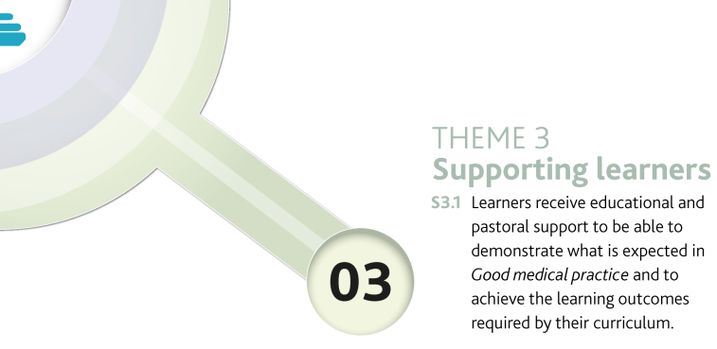
Theme 3: Supporting learners
Notes:
This theme is about making sure learners get effective educational and pastoral support.
[See also the requirements under this theme].

Slide 10

Theme 4: Supporting educators
Notes:
The theme is about making sure that educators have the necessary knowledge and skills for their role, and get the support and resources they need to deliver effective education and training.
[See also the requirements under this theme].

Slide 11
Theme 5: Developing and implementing curricula and assessments
Notes:
This theme is about making sure that medical school and postgraduate curricula and assessments are developed and implemented to meet GMC outcome or approval requirements.
NB: GMC has different statutory responsibilities for UG and PG
Sets outcomes for graduates that medical schools map to their curricula. Does not approve individual medical school curricula
Approves specialty curricula and assessment systems against the Standards for curricula and assessment systems. The Standards for curricula and assessment systems are being reviewed and are expected to be out for consultation later this year.
[See also the requirements under this theme].

Slide 12
Further information
Further information is available on the GMC’s website www.gmc-uk.org/education/standards.asp
To contact the GMC about the standards quality@gmc-uk.org
Notes:
Further information can be found on the GMC website including a set of frequently asked questions (FAQs).

