Slide 1
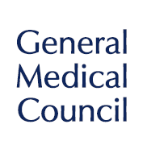
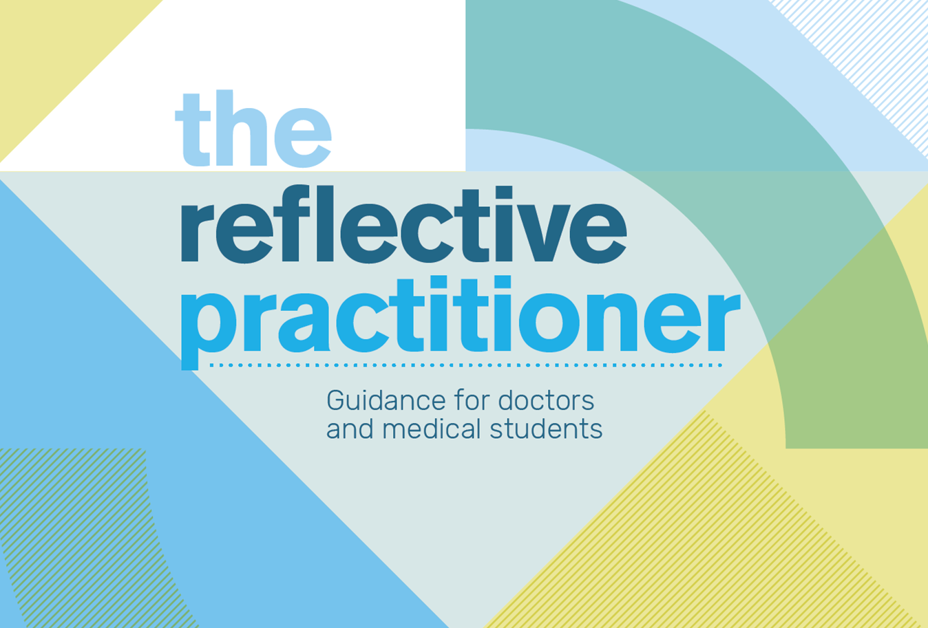
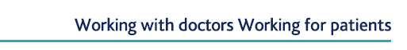
Notes:
Notes for facilitator - We have included a number of notes with each slide along with a clinical scenario that can be used. The notes are to guide some consistency of delivery of the package but can be appropriately adapted to the experience of the facilitator and the needs of the audience. The clinical scenario should be made available on paper. There are 2 different versions of the scenario in different clinical setting. We recommend only using 1 scenario and reviewing the 2 debrief videos linked to that scenario. We aim to highlight poor practice in reflection and model a more effective approach. This should be an interactive workshop for approx. 60 minutes but can be adapted to available time.
Introduce oneself, current role, own experience and title of the session

Slide 2
Quick pairs exercise - Reflection
Have a chat with your neighbour and find out
How confident they feel reflecting on their own practice.
How confident they are managing/having a reflective discussion in supervision or appraisal.
What are their concerns or worries about reflection?
What are the benefits of being a reflective practitioner?
(5 minutes maximum for exercise)
Be ready to feed back your partner’s response to the group.
Notes:
First Exercise – The icebreaker and temperature gauge
Aim - Initial exercise to get everyone talking and warmed up for the discussion and to be aware of existing views and opinions in the group.
Introduce this as an interactive workshop and participation rather than a presentation and that you are interested in everyone's views and any concerns.
Talking in pairs for no longer than 5 minutes.
Take feedback from a sample of people (there is unlikely to be time to do everyone if the group is big or time limited) – asking the person to report on their partner not themselves.
Have a flip chart and document on the left column benefits and right concerns (may want to come back to this to close the session at the end).
This will help people voice issues or barriers blocking their learning or change in views.
Suggestion to finish exercise – “Some trainees and doctors are understandably anxious about reflection and how their documentation may be used and there has recently been some confusion and misunderstanding. However, reflection is important for one’s own personal development and improving quality of care and patient safety. I hope by the end of the session we have reassured any fears or concerns you have had and can build on the benefits you have listed (point to the list on the flip chart)

Slide 3
Our aims
The aims of this session are to:
Improve the quality of personal reflection using appropriate frameworks
Improve the quality of an appraisal or supervision discussion around a specific incident
To know what and how to appropriately document a reflection and the supervision discussion
Promote the use of reflection for personal development and learning
Promote the use of reflection in quality improvement and improving patient safety
Demonstrate the benefits of being a reflective practitioner
Notes:
Clarify aims
State the aims

Slide 4
Outline
During this session we will:
Explore why reflection is important
Review the benefits of reflection
Discuss a clinical scenario
Observe a ‘reflective conversation’
Explore strategies to support effective reflection in the context of a supervision or appraisals discussion
Highlight best practice in documentation
Notes:
Clarifying the session structure, format, ground rules and confidentiality
Explain that the interactive session is approx. 60 minutes in total (can be modified if required for different audiences).
Explain the structure and format.
Emphasise that this is a workshop and will involve a lot of discussion. Remind them they will be working in pairs and small groups and to be respectful of everyone's views. Let them know they can interrupt and ask questions at any point.
“We are using a clinical case and it may be tempting to turn the session into a full root cause analysis. I want to ensure that the focus is on reflection and the supervision discussion so you may need to move them on to ensure that the whole session is covered and apologise that you may need to interrupt to keep to the schedule”.
Confidentiality states that the discussion should remain in the room, however, if anything is discussed that raises significant concern about patient or public safety and hasn’t previously been addressed, then this may not be able to remain confidential.

Slide 5

Why do we all need to reflect?
Reflection
‘The process whereby an individual thinks analytically about anything relating to their professional practice with the intention of gaining insight and using the lessons learned to maintain good practice or make improvements where possible.’
Co-produced guidance by AoMRC, COPMeD, GMC and MSC
Step 1
Have an experience
Step 1
Have an experience
Step 2
Review and
describe the
experience
Experiential
learning
Step 5
Plan the
next steps
Step 5
Plan the
next steps
Step 3
Analyse the
experience
Step 4
Draw conclusions
from the
experience
Step 4
Draw conclusions
from the
experience
Notes:
Definition of reflection and link to new Guidance
Clarifying the working definition and signposting the co-produced guidance now available with partner organisations. Emphasis on words in bold.
How we learn – Apprentice and experiential learning/Emphasis on using positive cases also and no one right way to reflect
“For trainees and students our most effective learning is as an apprentice in the working environment. We move from real experiences, analysing our actions and continuously refining the process as we move from novice to expert. For established doctors we maintain and develop our practice in a similar way. This is a simplified version of the Kolb learning cycle demonstrating experiential learning and how reflection is at the heart of this.
It is equally important to reflect on positive events and achievements to reinforce practice and learning and not just adverse incidents and complaints.
There is no one way to reflect, it can be done alone, with support or in a team. There are many different frameworks that can be used. It’s a personal thing and influenced by an individual’s learning style – what is important is the ability to demonstrate analytical thinking, insight and learning.”

Slide 6
The Reflective Practitioner
Reflection empowers medical students and doctors to:
Demonstrate insight by identifying actions that will help us learn, improve our practice and develop greater insight and self-awareness.
identify opportunities to improve quality and patient safety in organisations.
There is a strong public interest in medical students and
doctors being able to reflect in an open and honest way.
Notes:
Summarising why we need to be a reflective practitioner
Key point of this slide – “Our public also expects this of us so we need to know how to do this well, how to support an appraisal or supervision discussion around reflection and how to safely document the outcome of the discussions.”

Slide 7
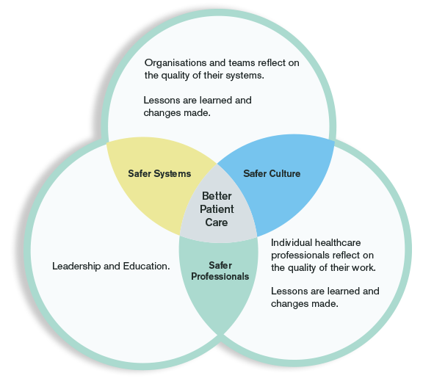
Benefits
Academy of Medical Royal Colleges/COPMeD.
A reflective practice toolkit, 2018. Reflective practice - an overview
Notes:
Benefits
Summarise why reflection is important – safer culture, safer systems, better patient care and safer professionals.
Emphasise it’s about the patient at the centre and individuals, organisations and those in education and leadership roles working together.
This diagram is from the Academy toolkit - Academy of Medical Royal Colleges/COPMeD. A reflective practice toolkit, 2018. Reflective practice - an overview.
www.aomrc.org.uk/wp-content/uploads/2018/08/MCJ15414-Academy-ReflectivePractice-Main-v3.pdf

Slide 8

What?
(thinking)
So what?
(feeling)
Now what?
(doing)
Framework for reflection
Notes:
Frameworks
Explain that there is a wide literature base around reflection and different examples are available to view in the guidance (What, So what, Now what as per slide image) and in the Academy/COPMeD reflective practice toolkit.
We have chosen the What, So what, Now what framework that’s featured in the guidance. You will recognise that this is what we have just used in the last exercise.
It’s a simple way to structure reflections, whether it be of a single event or a period of time. It could include personal experience, interaction or observation of others and formal/informal learning events.
It’s based on the work by Rolfe et al
Adapted from Rolfe, G. Freshwater, D & Jasper, M. (2001) Critical reflection for nursing and the helping professions: a user’s guide Basingstoke: Palgrave Macmillan

Slide 9

Explores thought processes when a particular action or decision was taken and how those may have impacted on actions and feelings.
‘What was I thinking when I took
the actions or made the decision
that I did?’
What?
(thinking)
So what?
(feeling)
Now what?
(doing)
Notes:
Framework continued

Slide 10

Involves considering the significance of what happened as well as the values and feelings at the time.
‘How did I feel at the time of and after
the experience, why was it important?’
What?
(thinking)
So what?
(feeling)
Now what?
(doing)
Notes:
Framework continued

Slide 11

What?
(thinking)
So what?
(feeling)
Now what?
(doing)
Looks at the processes and opportunities that can help learning from the experience and identifying future actions.
’What can I/we learn from or do differently next time?’
Notes:
Framework continued

Slide 12

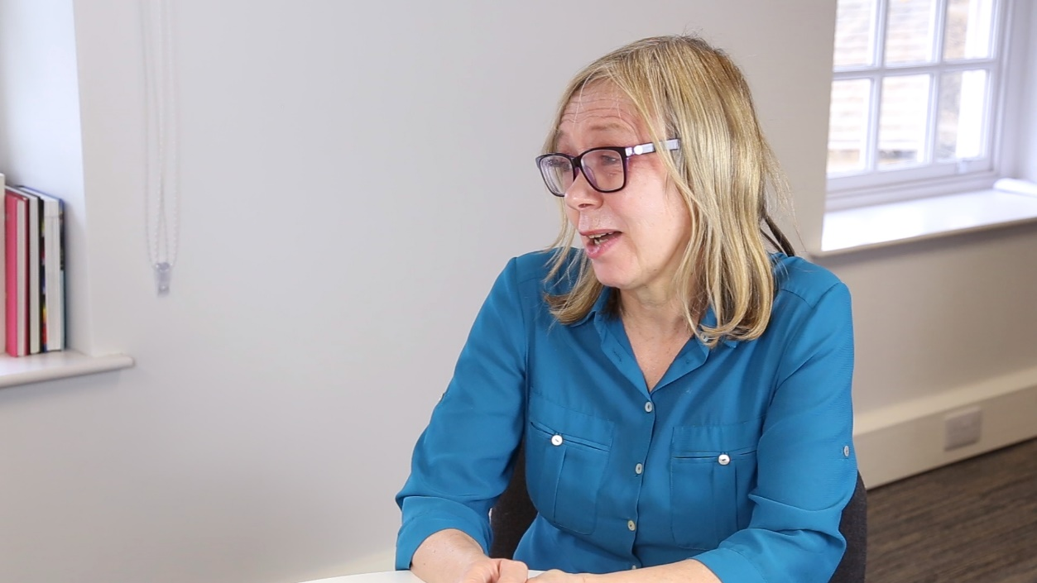
Case scenario 2 – Dr Dawson
Review the scenario in groups of 3-4
What happened?
So what does this actually mean?
Now what can they learn from this and change for the future?
Notes:
Exercise 2 – Use either scenario 2 exploring the case and elements of reflection using What, So what and Now what
Give them 10 minutes maximum for discussion and feedback.
Introduce the exercise and provide them with either case handout 2.
Ask them to read and then discuss in small groups (maximum 3-4) – try and put themselves in the shoes of the doctor. First to analyse what happened and what the doctor was thinking at the time when those decisions were made. What thoughts they may have had after the event with hindsight. Then what this means (so what) – what feelings the doctor may have experienced at the time and afterwards.
Ask them the Now what – what can be learned or changed for the future from this experience?
Get feedback – may have a mixture of emotions of blame/guilt or the opposite of frustration and denial – acknowledge the variations – if they are all the same, ask if there could be other ways the doctor may react.
Helpful to finish stating that when an individual reflects, they may be overly critical of their own actions and only see it from a personal failure perspective with a significant risk of second victim harm. They may lose all perspective and ignore the wider contributing factors and opportunity to improve systems. For others, there may be a complete lack of insight and a failure to demonstrate any learning or meaningful reflection.
Potential Contributing factors
Scenario 2
Time pressures, workload
Communication and follow up
Risk assessment of self-harm

Slide 13
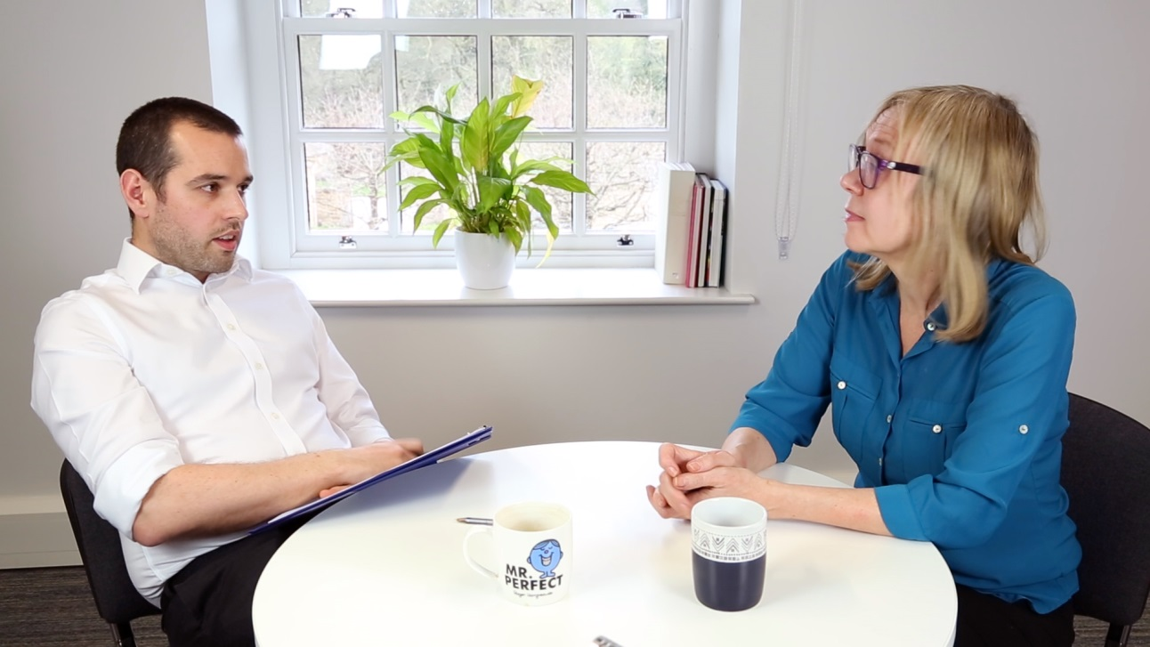
‘Learning conversation with appraiser’
Watch this interaction with Dr Dawson and their appraiser.
Think about
If there’s any structure
Any areas of good practice
Suggestions for improvement
Watch Video >
Notes:
Scenario 2

Slide 14

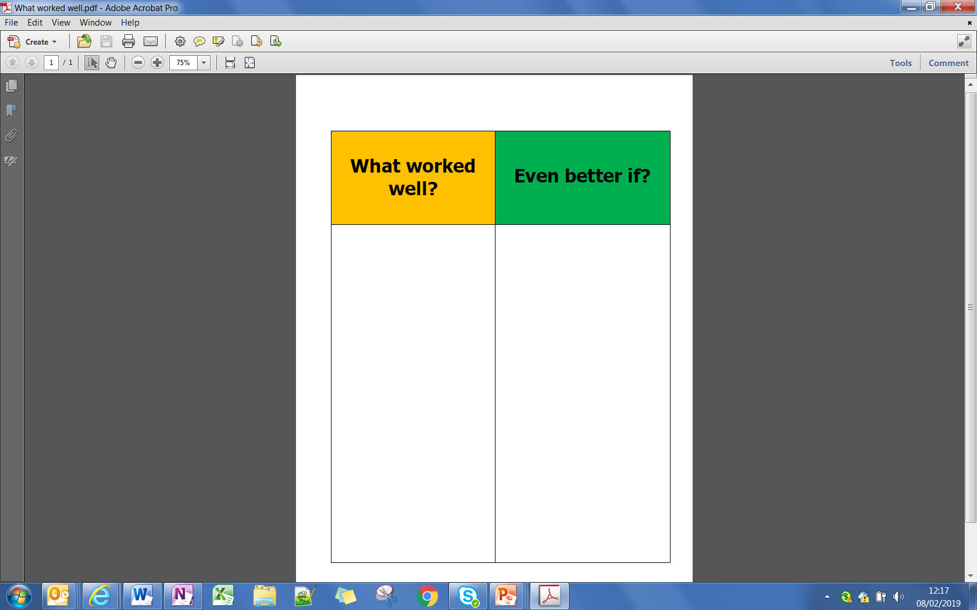
Review
Meeting 1
Tick box mentality Cynical “Nothing changes” No focus on learning or future actions
Notes:
Review the recordings
Then get whole group to feedback on key points – rather than asking everyone to shout out, ask individual people.
If they are focusing on the rights and wrongs of clinical practice move them away to feedback on the process – looking at elements such as the environment, communication and frameworks. Ask if there was any analytical thinking, insight, what conclusions/actions have been drawn?

Slide 15

Creating the right environment for an open reflective discussion
Notes:
Creating the right environment for an open reflective discussion
Summarise - For day-to-day practice and learning, a reflective discussion around a case or procedure with a colleague or supervisor is an ideal opportunity to unpack some thoughts and reflections – it’s timely, relatively safe and unthreatening. The learning can be logged by the learner in their own portfolio at leisure or recorded as supervised learning event (SLE) entry.
Ask the group – ‘For more challenging conversations, how do you optimise conditions and the environment to have an open and reflective meeting? Also what personal skills do you need for this discussion to be effective?’

Slide 16
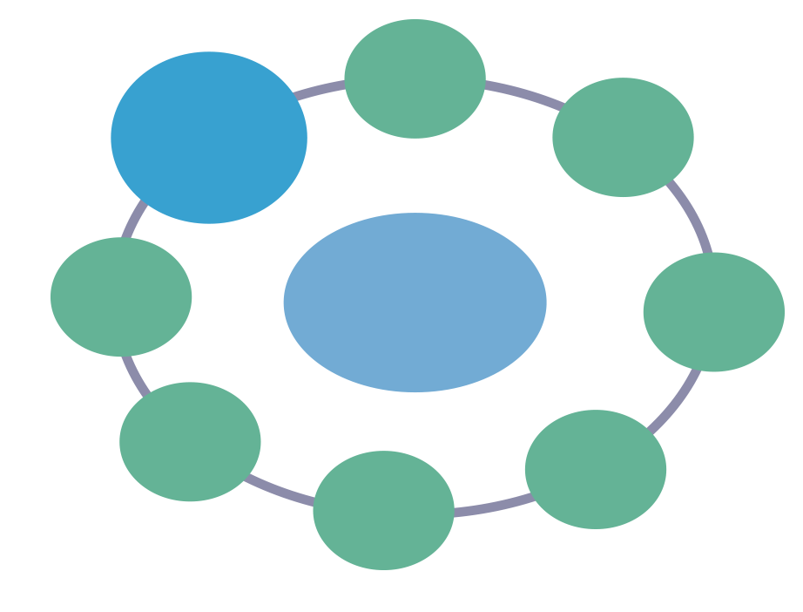
Appropriate time
Effective communication
Venue
Creating the right environment
for an open reflective discussion
Be aware of
hierarchy gradients
Request prior preparation
Be mindful of emotional impact and 2nd victim harm
Signpost
useful framework
Consider all contributing factors
Notes:
Keys principles to a successful learning conversation
Appropriate time – enough time at the right times and in the right place.
Appropriate venue – avoiding interruptions.
Encourage preparation and reflection prior to the meeting by the doctor (in the context of an appraisal you may wish to contact them and ask for more feedback/work).
Provide suggestions of useful templates and frameworks for reflection and documentation.
Consider (and encourage the learner to) all the contributing factors and not just from an individual perspective.
Be aware of the emotional impact on the doctor and second victim harm – may need a follow-on meeting or a need to signpost to support services.
It may also bring you to be overly caring and parental and therefore neglect developing insight and learning.
Be mindful of the power difference and hierarchy gradient between the appraiser and doctor which may impact on openness and how to manage this.
We’ve made effective communication a big box as this is the key skills – link to next skills

Slide 17


Effective communication – active listening
It’s all about communication and active listening skills.
Levels of listening
Superficial Words
Deeper Feelings
Deepest Meaning
Notes:
Communication
The key to holding an effective learning conversation in the context of a reflective episode is active listening. We often want to talk, interrupt and offer advice/opinions. If we pause and allow the conversation to flow with open questions and actively listen, the individual is more likely to open up and reflect. It’s important to have good rapport (be aware of body language and mirroring).
We need to move away from simply listening to the words – but actually how they are said, the intonation and body language will often give clues to real emotions, feeling and meanings.
We all know people who say yes when we ask if they’re okay, but their tone and body language says something completely different. We need to be aware if the words are congruent with all other elements of their communication.

Slide 18
Effective communication and the Framework
What
’Open questions to start the conversation.
The use of summaries back in the doctors own words can be powerful
Extending questions to maintain and build the discussion
  Develop that a bit more
  What were your thoughts when you took these actions or made the decision?
What?
(thinking)
So what?
(feeling)
Now what?
(doing)
Rebuild confidence in the process of reflection.
Notes:
Effective communication and the Framework
Examples of questions and phrases.
Summarising back in their own way can be powerful as they hear back what they have said, often the penny drops when they hear this version.
If the conversation stalls rather than offering input, try and get the individual to elaborate more – develop that a bit more, what is the real challenge here, etc.

Slide 19
Effective communication and the Framework
So What
‘How did you feel at the time of and after the experience, why was it important?’
How do you think others would have felt?
Now What
’What can you learn from or do differently next time’?
Are there any system or process changes required?
How are you going to take these forward?
What?
(thinking)
So what?
(feeling)
Now what?
(doing)
Rebuild confidence in the process of reflection.
Notes:
Effective communication and the Framework

Slide 20
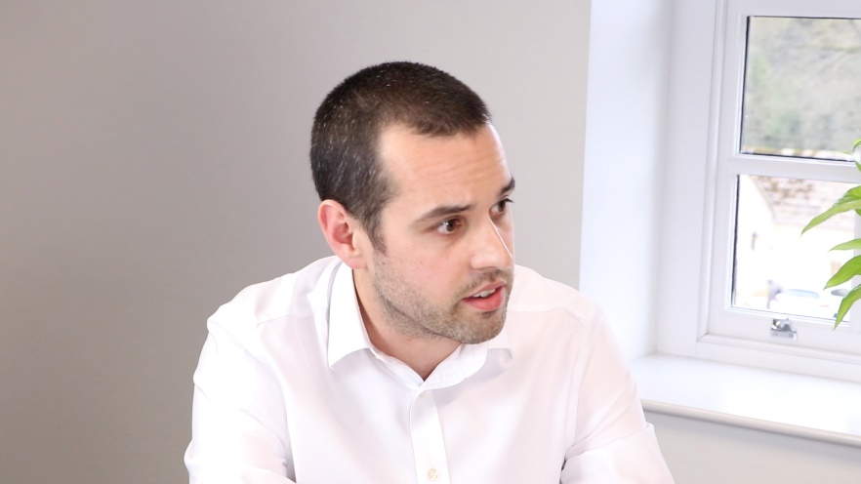
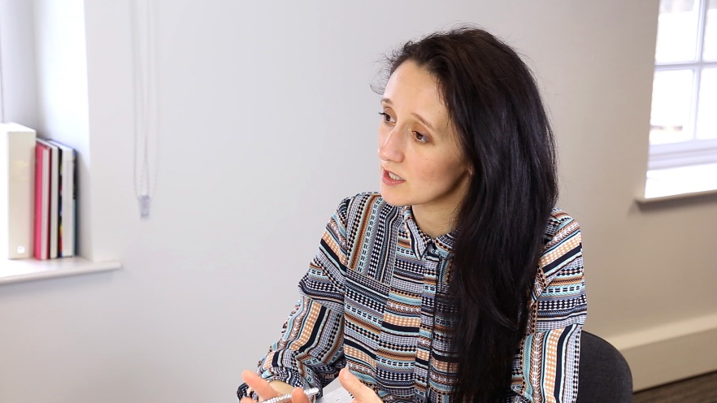
Avoiding confused messages
Check out
A mismatch of understanding can lead to ongoing confusion and distress leading to inappropriate reflection and learning
This is particularly important if there are cross cultural differences
At the end of the discussion ask the individual what they have understood from the conversation and will take away.
Rebuild confidence in the process of reflection.
Notes:
Effective communication and the Framework - Check out
In challenging discussions it is often easy to get a mismatch between what a individual takes away from the discussion and believes they’ve heard from what you may feel is discussed and said.
This is particularly important if there are cross cultural differences where particular phrases and words may have different meanings
This applies to all conversations clinical, supervision and even non-medical at home. At the end the session ask the learner what they have understood and will take away.

Slide 21
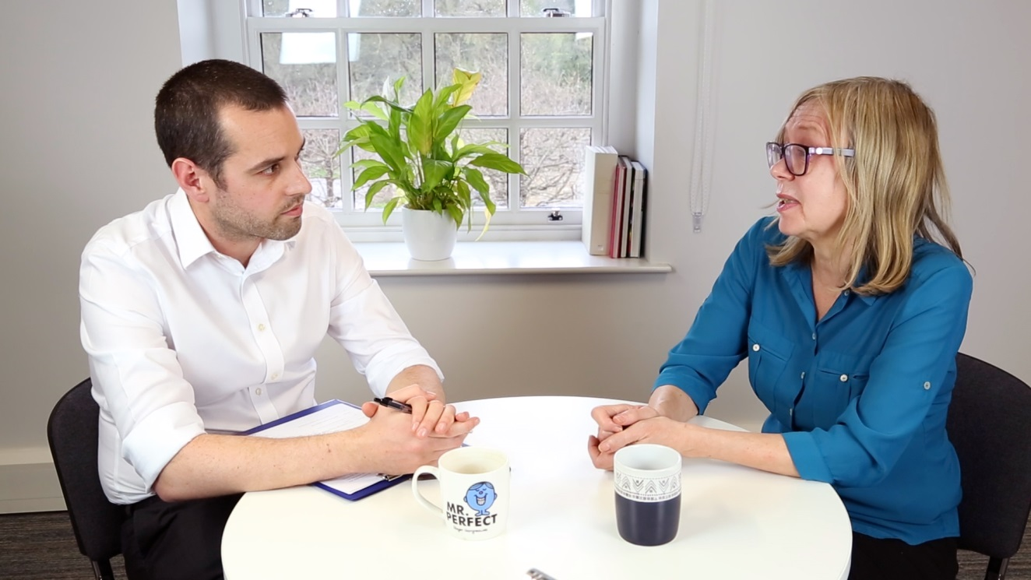
2nd meeting
Now watch the second video with the same doctors and appraiser as they undertake an effective reflective discussion
Compare and contrast the difference between the 1st and 2nd meeting
Notice who does most of the talking
Watch Video >

Slide 22

Demonstrating reflection
Discussing or writing down reflections as part of education, training and development.
  Focus equally on positive encounters and achievements, not only incidents or complaints
  Emphasis on quality rather than quantity
  Structure a note and capture learning outcomes and future plans
  Anonymise reflective notes as far as possible
Need time and space for individual and group reflection
Notes:
Demonstrating reflection
Discuss key points around demonstrating reflection:
Reflecting helps an individual to challenge assumptions and consider opportunities for improvement.
Sometimes doctors may want to discuss or write down their reflections, or may be required to as part of their education, training and development, in order to demonstrate:
Progression in training
Maintaining Good Medical Practice and revalidation
Evidence of engagement in QI and Patient safety work
Both positive and negative experiences can generate meaningful reflections.
Developing the capacity to reflect should focus on the reflective process and how to use it productively rather than on a specific number or type of reflective notes.
Thinking should be structured to capture, analyse and learn from the experience. A variety of tools are available to support structured thinking that help to focus on the quality of reflections. The focus is on key learning points and change in practice, not full details of an experience.
Anonymised information will usually be sufficient for all purposes other than the direct care of the patient, so should be used wherever possible. Ensure personal notes eg reflective diaries are also fully anonymised.

Slide 23

Group reflection
Often leads to ideas or actions that can improve patient care
Chance for open and honest team discussion when things go wrong
Notes:
Group reflection often leads to ideas or actions that can improve patient care.
The healthcare team should have opportunities to reflect and discuss openly and honestly what has happened when things go wrong.

Slide 24

Disclosure
Reflective notes can currently be required by a court
Don’t record actual details in reflective discussions – should be recorded elsewhere
Seek advice from a supervisor or appraiser if in doubt about the content
The GMC does not ask a doctor to provide their reflective notes in order to investigate a concern about them.
Notes:
Disclosure
Reflective notes, such as in learning portfolios or for revalidation or continuing professional development purposes, are not subject to legal privilege. Disclosure of these documents might be requested by a court if they are considered relevant.
Factual details should be recorded elsewhere in clinical statements not reflective templates as per the organisation’s policies, and should have already been discussed with the patient and/or their family. These are 2 different processes. Reflection should not substitute or override other processes that are necessary to record, escalate or discuss significant events and serious incidents.
Where a disclosure request is received, the owner of the learning portfolio or other reflective note should seek advice from their employer, legal adviser, medical defence organisation or professional association.
Where there are concerns or questions about the content of reflection, the advice of a supervisor or appraiser should be sought as to whether the information is appropriate. The purpose of the reflection is to indicate learning and, where appropriate, future plans.
The GMC does not ask a doctor to provide their reflective notes in order to investigate a concern about them. The focus in a fitness to practise investigation is on facts and evidence relating to a serious allegation. The doctor can choose to offer reflective notes as evidence of insight into their practice.

Slide 25
Questions
?
Notes:
Take time for a few questions before moving on to close and summarise

Slide 26

What, So what and Now what?
So What have you learned today?
Now What will you do going forward?
Notes:
Personal reflections and close with the flip chart from exercise 1
Ask the audience to consider one key thing they have learned today and one change in practice and record this in their CPD log. If there is time ask them all to feedback this back to the group – ‘group reflection’, if not, ask for one or two.
Return to the flip chart with the benefits and concerns and hopefully you have emphasised the benefits and concerns.

Slide 27
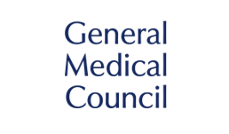


Acknowledgements
This training resource has been developed by the GMC with support from DoctorsTraining and Dynamic Business Services Ltd.

