Slide 1



TEAMWORK
Achieving good medical practice:
Working effectively in multidisciplinary healthcare teams

Slide 2
Aims & Objectives
Aim:
The purpose of this online learning resource is to help medical students understand what the joint GMC and MSC student professionalism guidance ‘Achieving good medical practice’ says about teamwork and how to work effectively within multidisciplinary healthcare teams.
Objectives:
Recognise stakeholders within a multidisciplinary healthcare team.
Understand the components of an effective team.
Explain the importance of effective teamwork within a multidisciplinary healthcare setting.
Differentiate between good and bad examples of communication, collaboration, and respect within a multidisciplinary healthcare team.
Identify challenges to effective teamwork within healthcare and apply practical methods to overcome them effectively.
Reflect on personal responsibilities within a team and identify methods to improve performance and overall patient care.

Slide 3
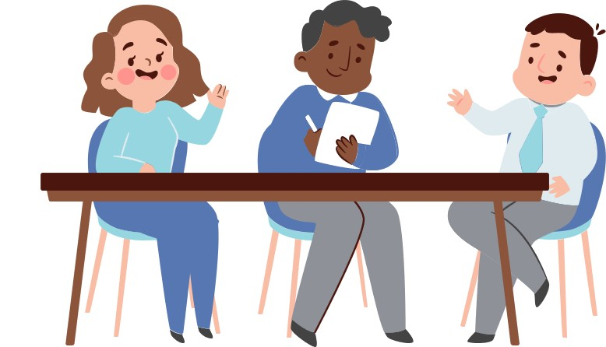
Introduction
What is a team?
A team is a small number of people with complementary skills who are committed to a common purpose, set of performance goals, and approach for which they hold themselves mutually accountable.¹
Why is team-working important as a medical student?
In an age where physicians are expected to function as effective members of multidisciplinary teams, developing collaborative skills as early as possible is crucial in ensuring good medical practice. Training medical students from early in their careers, according to various studies, has shown to reduce medical errors/adverse events and in turn has dramatic impacts on patient outcome. ⁷

Slide 4
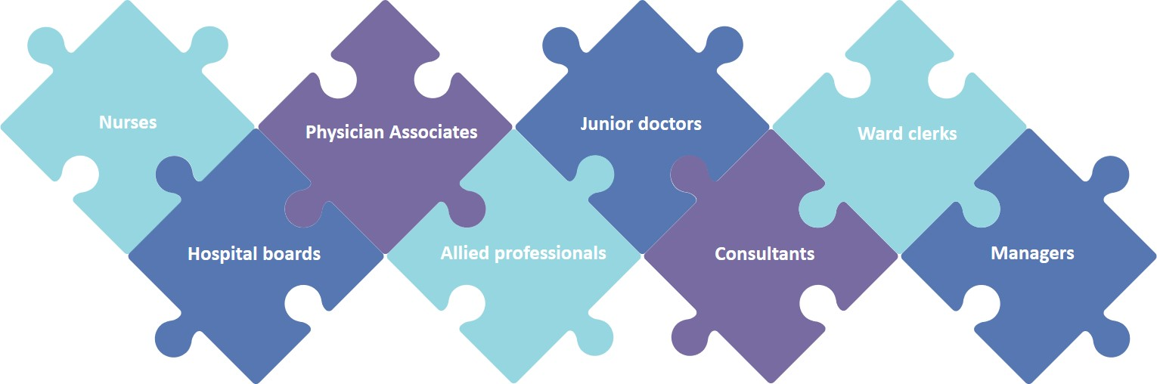
Multidisciplinary healthcare team
Throughout your career, you will be expected to work with and alongside various healthcare professionals.
Other than those identified below, identify 5 other professionals that you could be asked to work with.

Slide 5
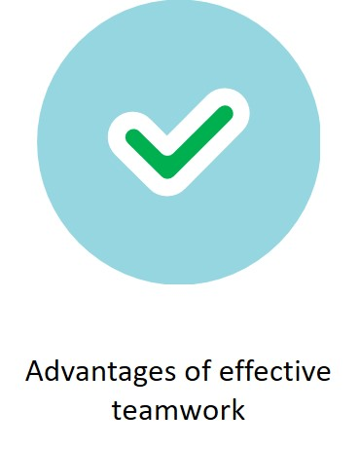


Exploration
Barriers to effective teamwork and ways to overcome them

Slide 6
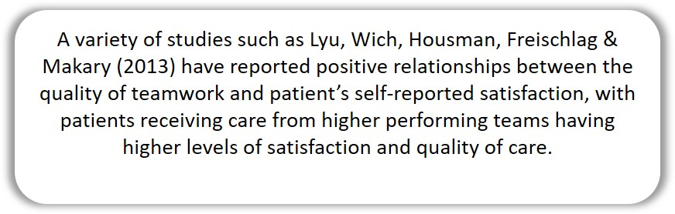
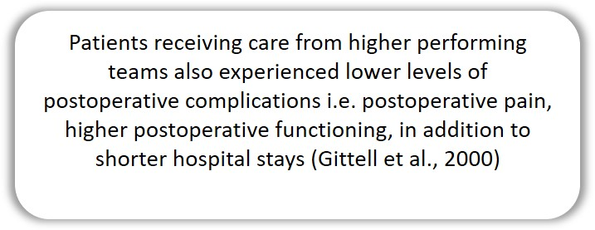
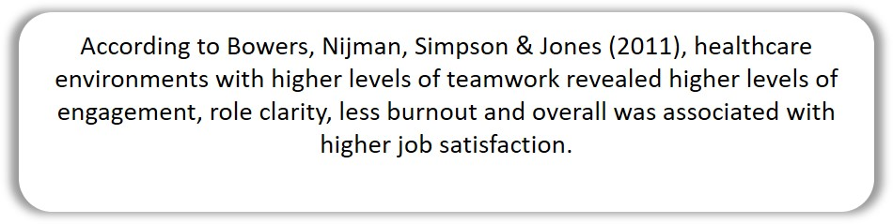
Advantages of teamwork
Based on your own knowledge, reflect on the advantages of good teamwork in a multidisciplinary healthcare team. Click on each advantage for more information.

Slide 7


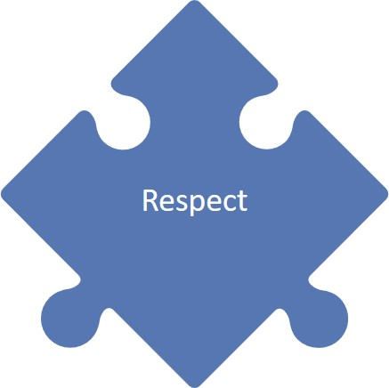
Pieces of effective teamwork

Slide 8

Communication
What is good communication?
“Good communication is the accurate and unbroken transmission of information that results in understanding” ³

Slide 9
Communication
Why is it important for medical students?
Failures in interprofessional teamwork and communication lead directly to compromised patient care, staff distress, tension and inefficiency. Studies have shown that communication failure is the root cause of 70% of medical errors.⁴ And so, effective communication is essential both within an individual team and between teams to ensure co-operation and coordination of care.³

Slide 10
ACTIVITY 1: Watch the next video and follow the instructions.

Slide 12
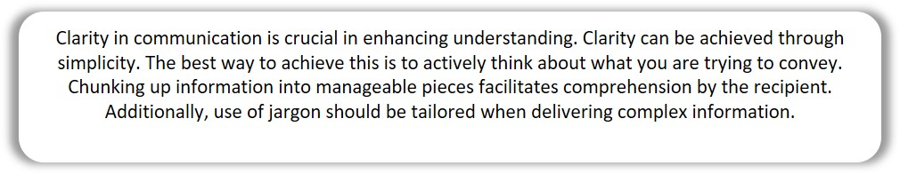

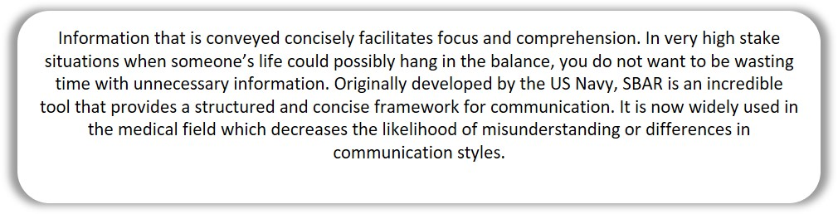

From the video, we can learn numerous
Strategies to improving communication:
Click on each button for more information

Slide 13
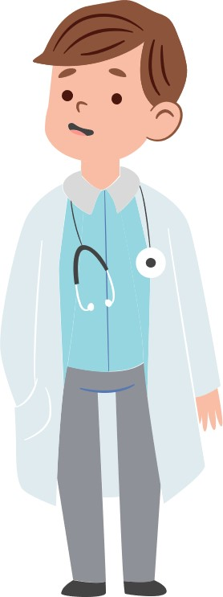
Collaboration
What is it?
Collaboration in healthcare is defined as “the alliance and cooperation between health care professionals, working together to reach a common goal or outcome. In this case, we have the shared responsibility to optimise and improve patients’ health and well-being”⁵

Slide 14
Collaboration
Why’s it important for medical students?
Collaboration between healthcare workers allows “awareness of each other’s type of knowledge and skills, leading to continued improvement in decision-making^{”5.} Without the alliance between healthcare workers, the teams care providing efficiency is decreased. It also becomes easier to lose sight of our common goal - the patients’ health and well-being.

Slide 15
ACTIVITY 2: Watch the next video and follow the instructions.

Slide 17
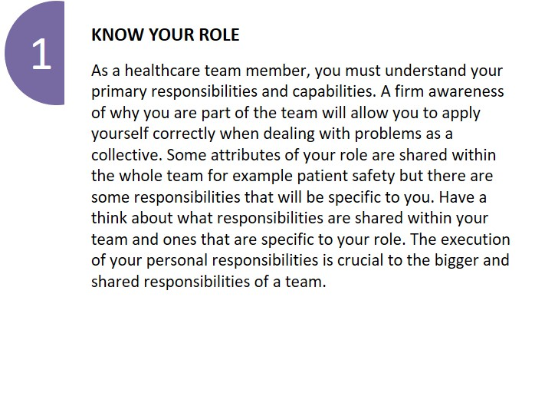
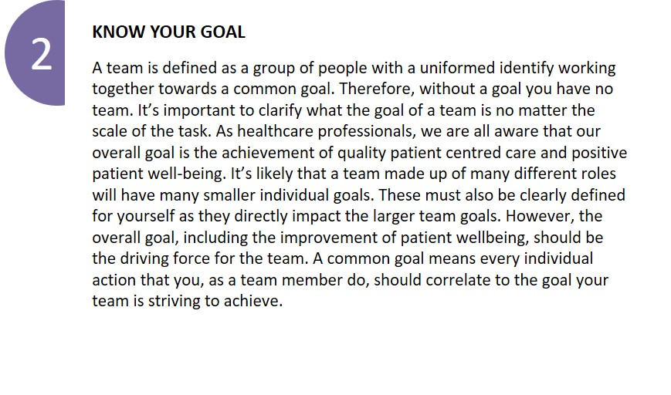
Here are a few
Strategies to improving collaboration:

Slide 18
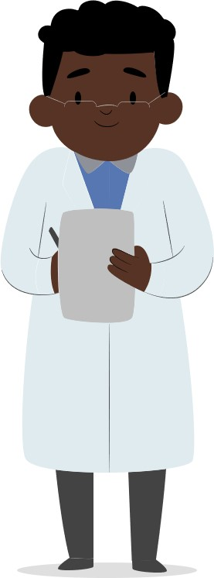
Respect
What is it?
Respect is the regard you show towards other peoples’ feelings, rights, and dignity. It can also be considered as a form of admiration for an individual’s skill sets or qualities.

Slide 19
Respect
Why is it important for medical students?
Within a healthcare team, respect is a fundamental basis for success. It drastically improves team dynamics, satisfaction, and efficiency. In environments where hierarchy can be a major barrier to team productivity, as a medical student, it is crucial to understand and implement respect in your day-to-day routine. Respect installs value. When everyone in the team feels valued, it allows for better understanding and collaboration; more efficient teamwork and improved overall patient care. Contrary to this, the consequences of disrespect can include “lowering staff morale, producing hostile environments, increase staff resignation, absenteeism and sadly, adverse events which have ended in patient mortality”¹³

Slide 20
ACTIVITY 3: Watch the next video and follow the instructions.

Slide 22
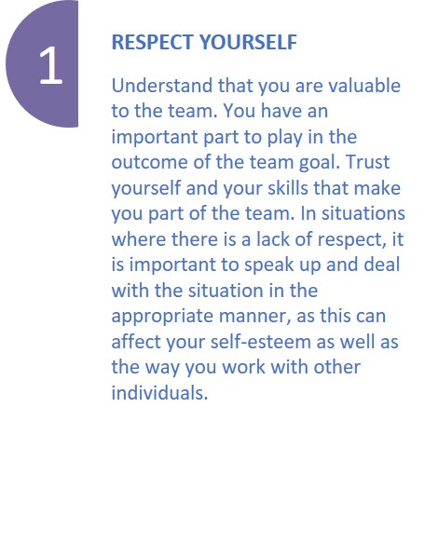
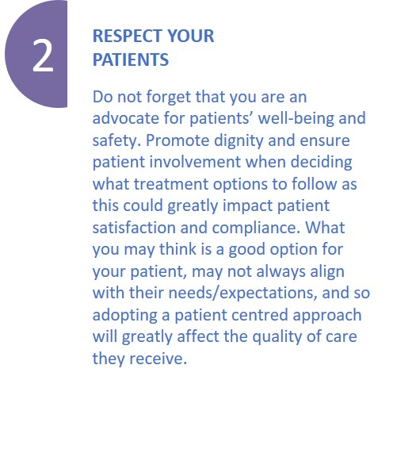
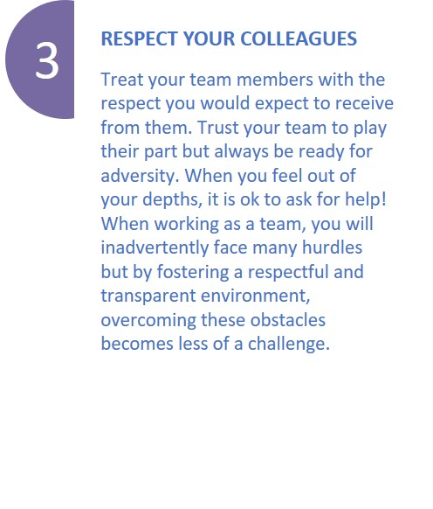
When dealing with respect,
Don’t forget to:

Slide 23
Barriers to teamwork
Using the table format below, reflect on the barriers that you, as medical student, may face in a clinical/non-clinical setting and potential ways that could be implemented to overcome them. You may use some of the examples outlined on the next slide to help you.
Barriers to teamwork | Ways to overcome these
e.g. Hierarchy | Team briefings and debriefings allows everyone within the team to introduce themselves without feeling intimidated. They provide a structured way for members of the team to speak up in a blame-free, supportive environment and are designed to improve team performance via reflection.⁶

Slide 24
Barriers to teamwork
Complexity of care
Personal values and expectations
Personality differences
Differences in language and jargon
Hierarchy

Slide 25
Quiz – Question 1
You are an FY1 on a busy medical ward. One of your registrar colleagues on your ward has made several prescribing errors that have resulted in a few near misses. Luckily no patient has come to harm. Rank in order the following actions in response to this situation (1 = Most appropriate; 5 = Least appropriate)
A. Talk to the registrar about your concerns
A. Talk to the registrar about your concerns
Correct answer: A, D, C, B, E
It is very important to communicate your concerns especially when patients’ lives are on the line. The main barrier to this teamworking situation is hierarchy, but it is good practice to speak directly to a colleague rather than go through an intermediary. This demonstrates trust and transparency and helps to create a good teamworking environment.
B. Observe your registrar’s prescribing for a week, to see if they make any
D. Talk to your educational supervisor to ask for advice on the situation
C. Talk to consultant to inform them about the situation
C. Talk to consultant to inform them about the situation
D. Talk to your educational supervisor to ask for advice on the situation
B. Observe your registrar’s prescribing for a week, to see if they make any
E. Don't interfere, it’s down to your seniors to deal with the situation
E. Don't interfere, it’s down to your seniors to deal with the situation
Reveal answer
View explanation

Slide 26
Quiz – Question 2
You are the registrar, and a 15-year-old girl presents to the surgery with her friend requesting an abortion. She has missed her last three periods. A pregnancy test is performed which turns out positive. She informs you that she does not want her parents to be made aware. Rank in order the following actions in response to this situation (1 = Most appropriate; 4 = Least appropriate)
A. Explore why she does not want her parents to know, discuss her options and if she wishes refer her for a termination of pregnancy
Correct answer: A, C, B, D
The patient is a key individual within a multidisciplinary healthcare team, and so, ensuring their wishes are being respected at all times is essential - if they have capacity. In this scenario, due to the patient’s age, they must be assessed for Gillick’s competence which states that “Children under the age of 16 can consent to their own treatment if they're believed to have … competence and understanding to fully appreciate what's involved in their treatment”. What must be avoided at all costs is to merely assume that the patient is not competent and disrespect them all together.
A. Explore why she does not want her parents to know, discuss her options and if she wishes refer her for a termination of pregnancy
C. Respect her decision, discuss her options and if she wishes refer her for a termination of pregnancy
B. Ask her to go for a course of counselling before referring for a termination
B. Ask her to go for a course of counselling before referring for a termination
C. Respect her decision, discuss her options and if she wishes refer her for a termination of pregnancy
D. Ask the patient to wait in the waiting room whilst you phone her mother and ask her what she wants to happen
D. Ask the patient to wait in the waiting room whilst you phone her mother and ask her what she wants to happen
Reveal answer
View explanation

Slide 27
Quiz – Question 3
You are an FY1 on the endocrine ward. You have been there for over a month and the workload does not seem to be easing up, and you often find yourself working alone on the ward due to rota gaps. You have begun to feel swamped in work, stressed, and unable to cope. Select the THREE most appropriate actions to take in this situation.
A. Inform the Programme Director at your hospital
Correct answer: A, C & E
Our priority must always be the patient, however, we must not forget to prioritise our own wellbeing. Respecting yourself and your mental health is extremely important when delivering patient centred care and even more so when working in a healthcare team. Fatigue and burnout are one of the commonest causes of errors within medicine and so, we must communicate honestly and openly with our team members when situations like this arise.
A. Inform the Programme Director at your hospital
B. Continue to work as you are
C. Discuss with your clinical supervisor
C. Discuss with your clinical supervisor
D. Take a few days off
E. Speak to your colleagues and discuss ways to divide the workload amongst each other
E. Speak to your colleagues and discuss ways to divide the workload amongst each other
Reveal answer
View explanation

Slide 28

Take-home points
The purpose of this online learning resource is to help medical students understand what the joint GMC and MSC student professionalism guidance ‘Achieving good medical practice’ says about teamwork and how to work effectively within multidisciplinary healthcare teams. Access the document by clicking on the image on the right.
The following points are a summary of how to achieve effective teamworking within a multidisciplinary healthcare team:
Communication: Be clear! Be concise!
Collaboration: Know your role! Know your goal!
Respect: Respect yourself, your patients and your colleagues!

Slide 29
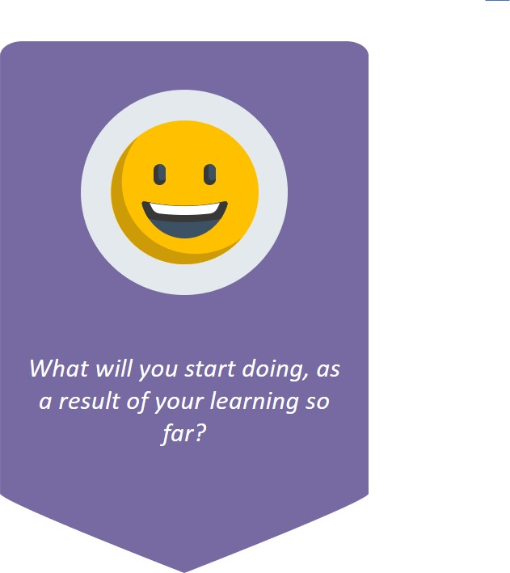

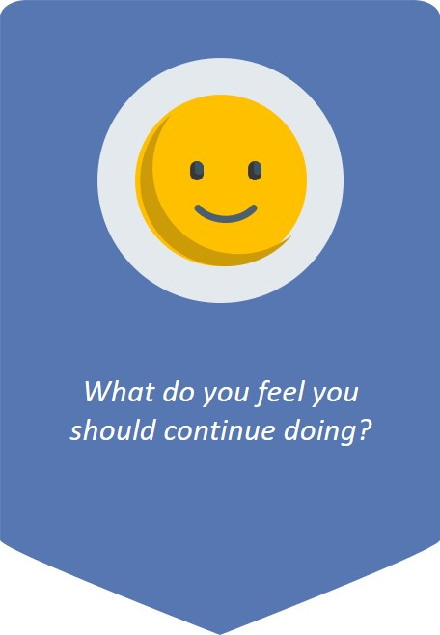
Take some time out to reflect on the following:

Slide 30
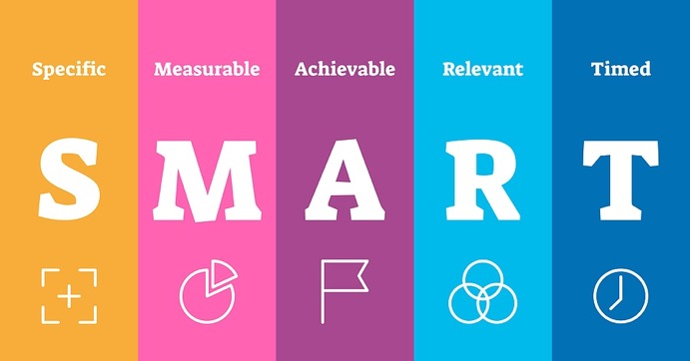
Top tip for structuring your goals: Use the SMART principles!

Slide 31

E-learning module completed!
Thank you for participating in this e-learning module. We would love to hear your opinions. Please scan the QR code to submit a feedback form on your experience.

Slide 32
References
R. Katzenbach, J. and Smith, D., 1993. The Discipline of Teams. [online] Harvard Business Review. Available at: <https://hbr.org/1993/03/the-discipline-of-teams-2> [Accessed 1 September 2021].
2021. Topic 4: Being an effective team player. [ebook] WHO. Available at: <http://www.who.int/patientsafety/education/curriculum/who_mc_topic-4.pdf> [Accessed 1 September 2021].
Dutta, D., Tweedie, D., Peake, D. and Goddard, D., 2017. Improving teams in healthcare Resource 3: Team communication. [ebook] Royal College of Physicians. Available at: <https://www.rcem.ac.uk/docs/External%20Guidance/ITIH%20R3%20Final.pdf> [Accessed 1 September 2021].
Weller, J., Boyd, M. and Cumin, D., 2014. Teams, tribes and patient safety: overcoming barriers to effective teamwork in healthcare. Postgraduate Medical Journal, [online] 90(1061), pp.149-154. Available at: <https://pmj.bmj.com/content/90/1061/149> [Accessed 1 September 2021].
O’Daniel, M. and Rosenstein, A., 2008. Patient Safety and Quality: An Evidence-Based Handbook for Nurses.. p.https://www.ncbi.nlm.nih.gov/books/NBK2637/
2019. The NHS Patient Safety Strategy. [ebook] NHS. Available at: <https://www.england.nhs.uk/wp-content/uploads/2020/08/190708_Patient_Safety_Strategy_for_website_v4.pdf> [Accessed 1 September 2021].
nhs.uk. 2019. Consent to treatment - Children and young people. [online] Available at: <https://www.nhs.uk/conditions/consent-to-treatment/children/> [Accessed 22 September 2021].
2016. Achieving good medical practice: guidance for medical students. [ebook] GMC. Available at: <https://www.gmc-uk.org/-/media/documents/achieving-good-medical-practice-20210722_pdf-66086678.pdf?la=en&hash=AE1A1C9484F7E3D7F510EC7D892F278F547704F4> [Accessed 1 September 2021].
Rosen, M., DiazGranados, D., Dietz, A., Benishek, L., Thompson, D., Pronovost, P. and Weaver, S., 2018. Teamwork in healthcare: Key discoveries enabling safer, high-quality care. American Psychologist, [online] 73(4), pp.433-450. Available at: <https://www.ncbi.nlm.nih.gov/pmc/articles/PMC6361117/> [Accessed 22 September 2021].
Babiker, A., El Husseini, M., Al Nemri, A., Al Frayh, A., Al Juryyan, N., O Faki, M., Assiri, A., Al Saadi, M., Shaikh, F. and Al Zamil, F., 2014. Sudanese Journal of Paediatrics, [online] 14, pp.9-16. Available at: <https://www.ncbi.nlm.nih.gov/pmc/articles/PMC4949805/> [Accessed 1 September 2021].
n.d. What’s a S.M.A.R.T goal?. [image] Available at: <https://www.clicdata.com/blog/how-to-set-smart-goals-for-your-business/> [Accessed 1 September 2021].
slidesgo, 2019. Clinical Case 04-2019. [image] Available at: <https://slidesgo.com/theme/clinical-case-04-2019> [Accessed 1 September 2021].
Grissinger M. Disrespectful Behavior in Health Care Its Impact, Why It Arises and Persists, And How to Address It—Part 2. [Internet]. 2017 [cited 1 September 2021];. Available from: https://www.ncbi.nlm.nih.gov/pmc/articles/PMC5265230/

